Slide 1
IoT Smart Lighting System
William Hawkins, Davis Piercy John Reed | 26 APR 2022 | ECSE 4660/6660

Slide 2

Agenda
Overview
Design
Implementation
Conclusions

Slide 3
Overview
Customizable lighting system
Energy Efficient
Constant Brightness
Security
Notes:
Davis
Our project is a smart room. The goal is to create a lighting system that is customizable as well as energy efficient. One of the main features of this project is the ability to keep the room a constant brightness. Combining this with the ability to turn the light off if no activity is detected are what make this more energy efficient than your typical lighting system. There are multiple sensors and raspberry pi’s used so it was important to make the system secure and how that was done is discussed in a later slide.

Slide 4
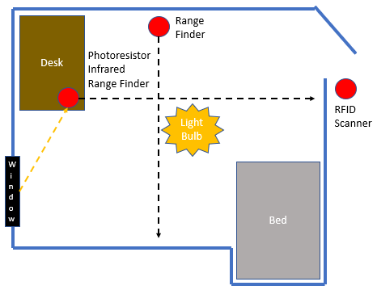
Design
Scan ID
Turn on Lights
Detect if person in room
If not, turn off light

Slide 5
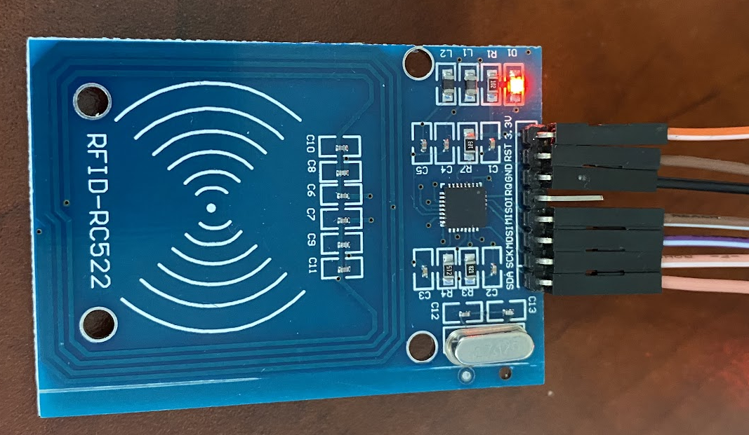
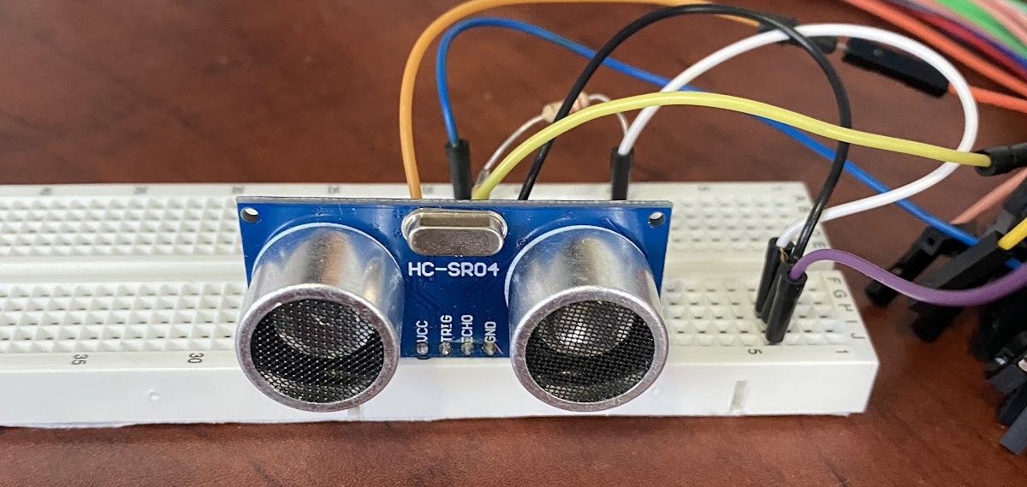
Implementation
2 RPis set up around room connected to sensors + RFID at Door
Range Finder
Infrared Sensor
Photoresistor
Notes:
Davis
Now I will discuss how the system works at the top level. Users scan a tag on the RFID sensor which turns on the light if the user is authorized. In order to keep the room a constant brightness a photoresistor is used to measure the light in the room and then the intensity of the light bulb can be increased or decreased accordingly. Two ultra sonic range finders are positioned in the room and are used as motion detectors. These coupled with an infrared sensor will cause the light to be turned off if nobody is detected in the room for 5 minutes. Now I will let Will discuss how these processes are implemented.

Slide 6

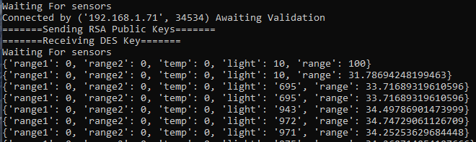

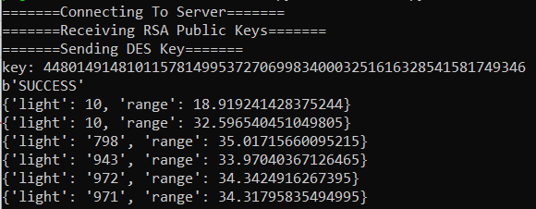
Implementation

Slide 7


Security
Secure Handshake To Authenticate Sensors
Use RSA to establish DES Key
Sensors must provide valid Token to connect
Communications encrypted with DES
Home Base disconnects connection if something is sus
Notes:
When the System is Booted up we use a Secure Handshake Protocol to connect all the Raspberry Pi’s to the Home Base.
The HQ will first open a TCP socket and will begin accepting connections.
A Sensor/Pi can then connect to the socket. The HQ will then send the Pi it’s public RSA keys. Using these RSA keys the pi will encrypt its secure authentication token known only to it and send it to the HQ along with a newly generated DES key.
The HQ decrypts the token and then Hashes it using SHA1 and compares it against its records. This practice is known as Salt & Hashing and increases security because HQ does not actually know the PIs authentication token.
If the token checks out the Pi is validated and can begin to transmit data to the HQ using DES. If at any point the HQ determines something is wrong the connection is terminated.
This scheme ensures the integrity and security of the system by protecting against Man-In-The-Middle and Known Ciphertext and Plaintext Attacks as well as protecting user data.

Slide 8
Conclusion
Successful implementation of design
Sensors operate in parallel
System is secure
Energy efficient
For Demo
Range finder limitations
Communication from RPi to Light bulb
Notes:
John

